Slide 1
Emotion recognition system for the humanoid robot NICO
Projektový seminár 2
MENO: Šimon Strieška
ŠkoliteľKA: Kristína Malinovská

Slide 2
Emotion Recognition
Recognizing emotion using data like face images, video
We analyse the expression, trying to classify a discrete emotion
Used in human-robot interaction, medicine, security
Approaches using deep learning require large amount of data

Slide 3
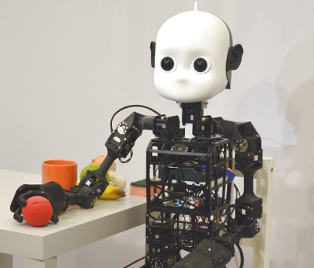
Goals
Research neural network models for emotion recognition
Use and analyse the Affectnet dataset and its challenges
Improve classification of underrepresented classes using augmentation
Analyse and visualize inner model representations
Study, develop and systematically test different
strategies for class imbalance
Create and calibrate the system for NICO

Slide 4
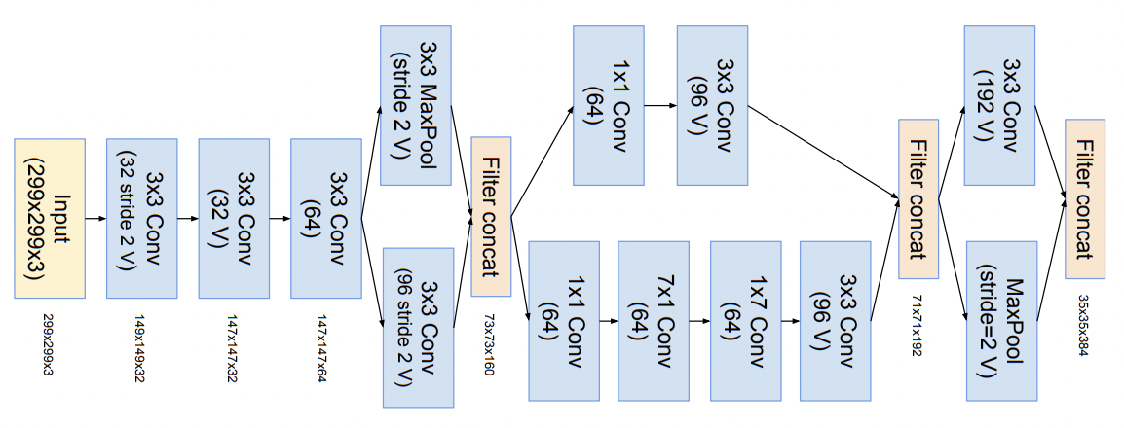
Architectures
ImageNetV1 based ResNet50, VGGFace2 based ResNet50, VGGFace2 based Inception ResNet50 V1
VGGFace2 models preform better
Concerns over model size when deploying on NICO

Slide 5
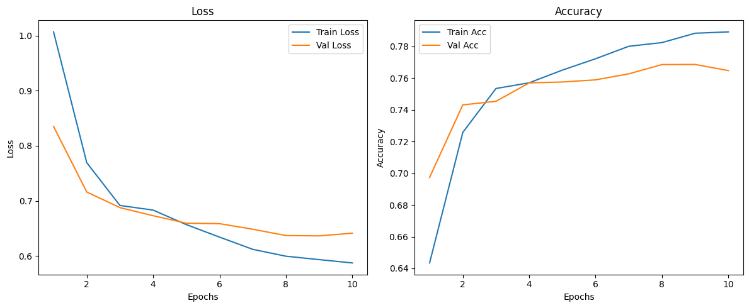
Ensambling
2 different approaches
Mixed results
Potential way of balancing dataset

Slide 6
1 vs rest ensamble
Similar performance to general model
Highlighted weak classes despite class balance
Further work needed on individual struggling models

Slide 7
Analysis using SOM
Displays overlap between certain classes in the training set
Certain classes more dispersed that others
Planned comparison with future models

Slide 8
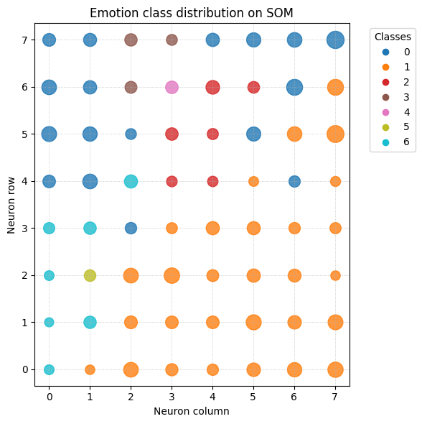
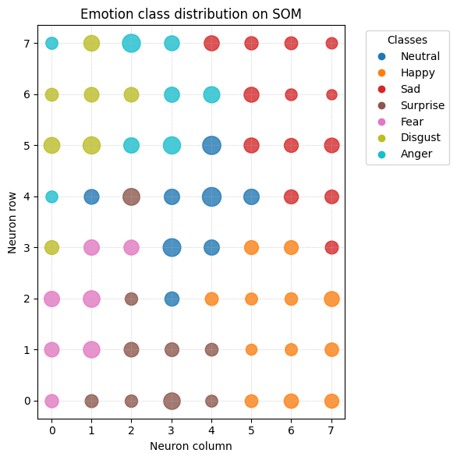
Analysis using SOM
Training set
Testing set

Slide 9
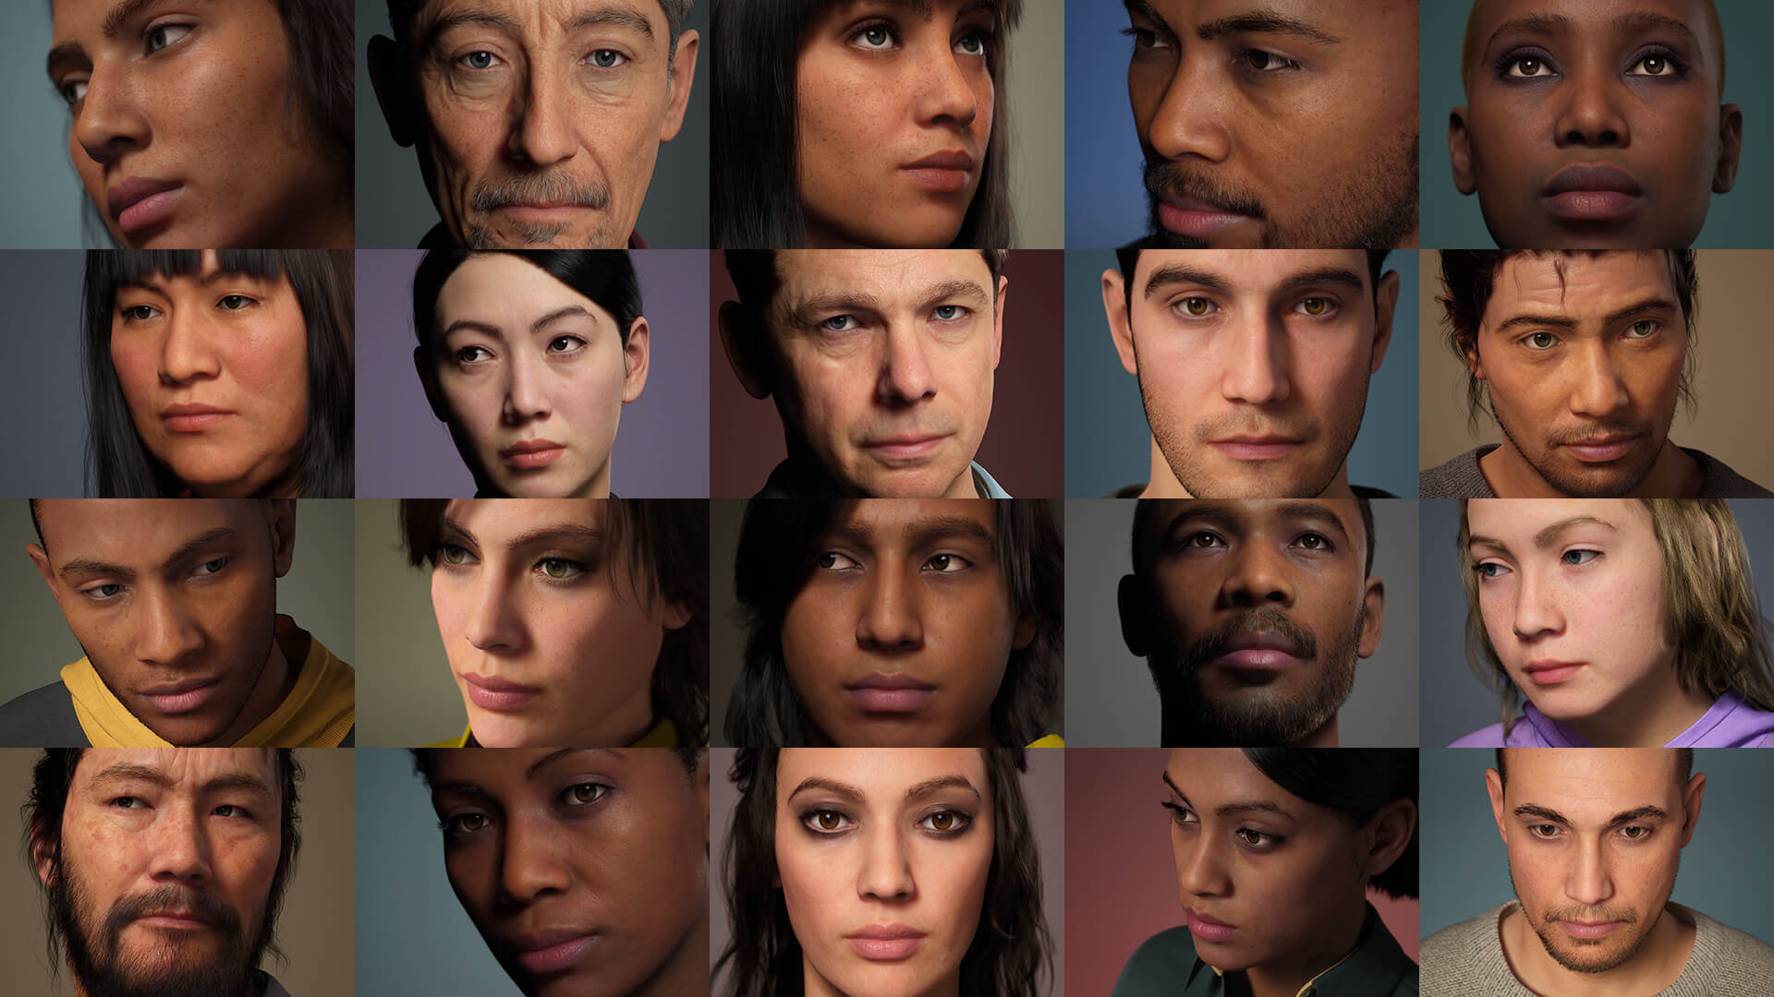
StarGANv2 and Unreal
Work in progress
Allows for advanced augmentation/generation of new samples

Slide 10
Future work
Increase model performance
Experimentation with Unreal and GAN
Concept analysis
Integration with NICO

Slide 11
Thank you for your attention

